Slide 1
Examples
Object Orientated Analysis and Design
Benjamin Kenwright

Slide 2
Outline
Revision Questions
Group Project
Review Deliverables
Example System Problem
Case Studey

Slide 3
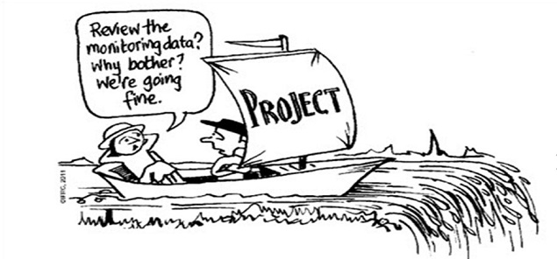
Group Project

Slide 4
Milestone Dates
Demonstrate Date
Submission Deadline
Exam
2 Hours
NOT Multiple Choice

Slide 5
Case-Study Example
Vision to Requirements
Manage Complex System
Develop Solution
UML Diagrams/Visualize Problem/System

Slide 6

Example Develop
Course Registration System

Slide 7
Course Registration System
What are we trying to build?
Customer’s problem?
Expand upon the vision statement and associated high-level requirements and constraints
Researching/evidencing
Facts

Slide 8
Simplification
Develop simplified perspective of the problem
Levels to manage the complexity

Slide 9
Ground-Work
Engineering Steps
Realization of a Successful System
System Requirements
Elements and Sub-Systems
Allocation and Interconnection
Meet the System Requirements

Slide 10
Vision Statement
Provide an effective and affordable course registration service for students
Functional Requirements
Provide course registration service
Operate the course registration service
Maintain the course registration service
Nonfunctional Requirements
Level of reliability to ensure adequate service guarantees
Sufficient accuracy to support current and future user needs
Constraints
Compatibility with other systems/standards
Maximal use of commercial-off-the-shelf (COTS) hardware and software

Slide 11
Basic Mechanics
Step 1
• Get the student registration number and his date of birth.
• The registration number should be verified with the existing database of valid registration numbers.
Step 2
• Get the cutoff.
• Compare the cutoffs and record the cutoff along with the student’s registration time.
Step 3
• Display the colleges, whose required cutoff is less than or equal to the student’s total cutoff mark.
• The student must choose his preferred college.
• Display the available courses in the selected college.
• The student must now choose his preferred course.
Step 4
• The student must finally be informed that he has been registered successfully

Slide 12
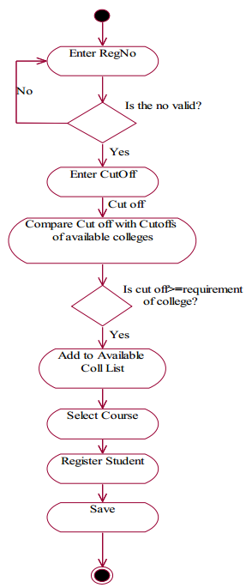
Activity Diagram

Slide 13
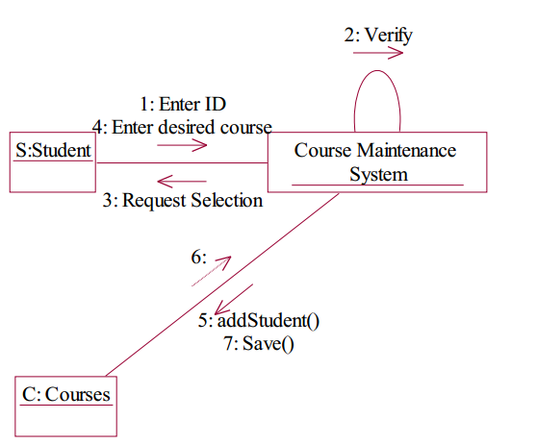
Collaboration Diagram

Slide 14
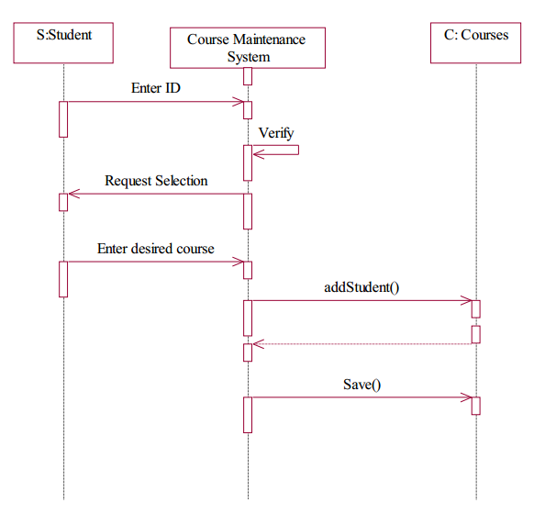
Sequence Diagram

Slide 15
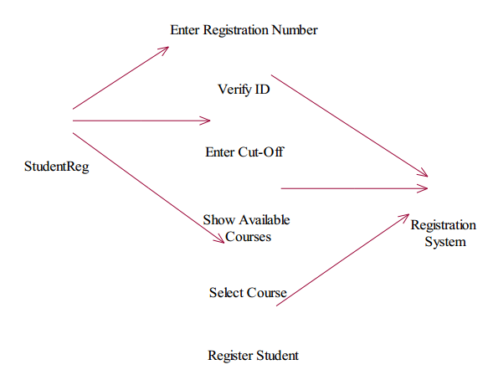
Use Case Diagram

Slide 16
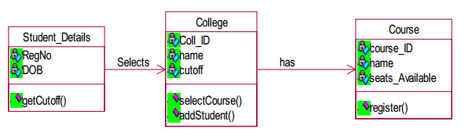
Class Diagram

Slide 17
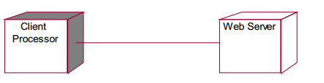
Deployment Diagram

Slide 18
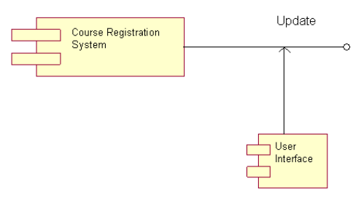
Component Diagram

Slide 19
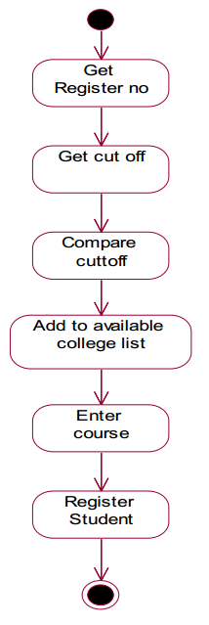
State Chart Diagram

Slide 20
Design/Verification
Testing/verification
Compare against original design
User feedback

Slide 23
Question
Which of the following mechanisms is/are provided by Object Oriented Language to implement Object Oriented Model?
A. Encapsulation
B. Inheritance
C. Polymorphism
D. All of the mentioned

Slide 24
Answer
D. All of the mentioned

Slide 25
Question
Which of these is the functionality of ‘Encapsulation’?
A. Binds together code and data
B. Using single interface for general class of actions
C. Reduce Complexity
D. All of the mentioned

Slide 26
Answer
A. Binds together code and data
`Encapsulation' acts as protective wrapper that prevents code and data from being accessed by other code defined outside the wrapper

Slide 27
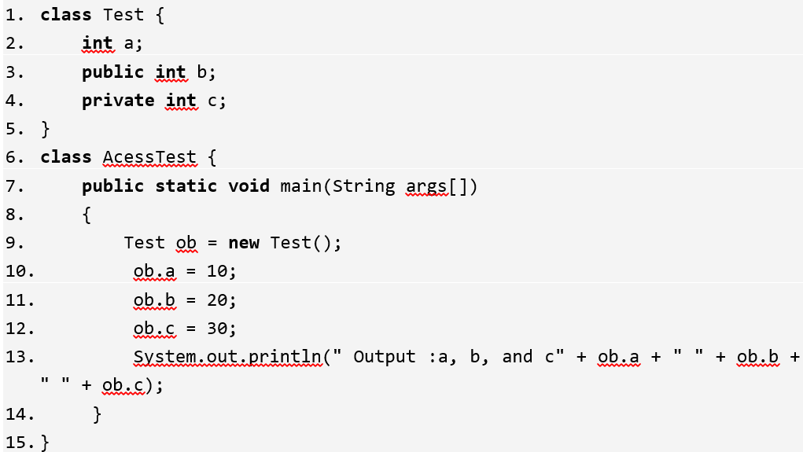
What is the output of this Program?
A. Compilation error
B. Run time error
C. Output : a, b and c 10 20 30
D. None of the mentioned

Slide 28
Answer
A. Compilation error
Explanation: Private members of a class cannot be accessed directly. In the above program, the variable c is a private member of class ‘Test’ and can only be accessed through its methods.

Slide 29
Question
Object-oriented design methods cause security problems as they don’t use object-based and object-oriented programming languages
True
False

Slide 30
Answer
b) False
Object-oriented design methods have evolved to help developers exploit the expressive power of object-based and object-oriented programming languages

Slide 31
Question
What are the three important parts of Object-Oriented Programming (OOP)?
uses objects; each object is an instance of some class; classes may be related to one another via inheritance
use modules; hierarchical structure; structures must be related to one another via inheritance
hierarchical structure; collection of objects; objects must be related to one another via polymorphism

Slide 32
Answer
A. uses objects; each object is an instance of some class; classes may be related to one another via inheritance

Slide 33
Question
The three minor elements of the object model are:
a) Abstraction, Encapsulation, Inheritance
b) Modularity, Persistence, Concurrency
c) Concurrency, Persistence, Typing
d) Persistence, Abstraction, Concurrency

Slide 34
Answer
c) Concurrency, Persistence, Typing

Slide 35
Question
Abstraction and encapsulation are not complementary concepts
True
False

Slide 36
Answer
b) False
Abstraction and encapsulation are complementary concepts

Slide 37
Question
For abstraction to work, implementations must be encapsulated
True
False

Slide 38
Answer
a) True

Slide 39
Question
Why is modularity important?
Enables us to partitioning a program into individual components can reduce its complexity
Enables us to develop more optimised algorithms
Modularity causes issues with boundaries (or interfaces) within the program

Slide 40
Answer
a) Enables us to partitioning a program into individual components can reduce its complexity

Slide 41
Question
Encapsulation is avoided through information sharing, which is the process of showing all the secrets of an object that do not contribute to its essential characteristics
True
False

Slide 42
Answer
a) False
Encapsulation is achieved through information hiding (not just data hiding), which is the process of hiding all the secrets of an object that do not contribute to its essential characteristics

Slide 43
Revision Question
What is an advantage of polymorphism?
a) The same program logic can be used with objects of several related types.
b) Variables can be re-used in order to save memory.
c) Constructing new objects from old objects of a similar type saves time.
d) Polymorphism is a dangerous aspect of inheritance and should be avoided.

Slide 44
Answer
a) The same program logic can be used with objects of several related types.

Slide 45
Question
Classification is relative to the perspective of the observer doing the classification
True
False

Slide 46
Answer
a) True

Slide 47
Question
Which of the following supports the concept of hierarchical classification?
a) Polymorphism
b) Encapsulation
c) Abstraction
d) Inheritance

Slide 48
Answer
d) Inheritance
Use of Hierarchical classification avoids defining the properties of object explicitly at each level which have acquired their properties from higher levels.

Slide 49
Revision Question
Requirements analysis is critical to the success of a development project.
a) True
b) False
c) Depends upon the size of project

Slide 50
Answer
Answer a)
Explanation: Requirements must be actionable, measurable, testable, related to identified business needs or opportunities, and defined to a level of detail sufficient for system design

Slide 51
Question
Requirements should specify ‘what’ but not ‘how’.
a) True
b) False

Slide 52
Answer
Answer: a)
Explanation: ‘What’ refers to a system’s purpose, while ‘How’ refers to a system’s structure and behavior.

Slide 53
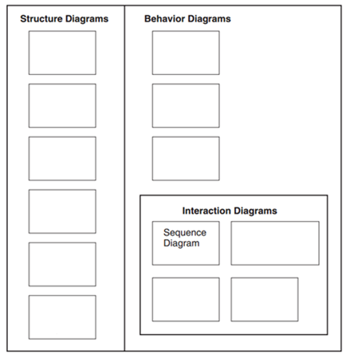
Revision Question
List the various UML Diagram Types

Slide 54
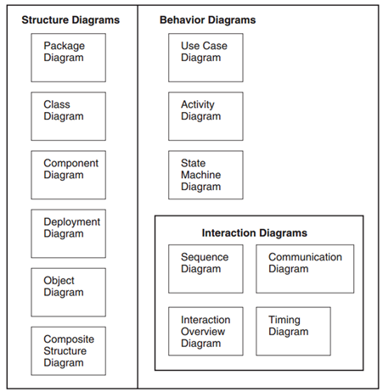
Answer

Slide 55
Question
Is a “Class Diagram” a static or dynamic system model view?
Static (or Structural)
Dynamic (or Behavioral)

Slide 56
Answer
Static (or Structural)

Slide 57
Question
The three essential elements of a deployment diagram are:
a) nodes, connections and their elements
b) artifacts, nodes, and their connections
c) elements, relationships and connectors
d) inheritance, relationships and connectors

Slide 58
Answer
b) artifacts, nodes, and their connections

Slide 59
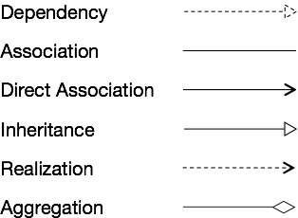

Revision Question
Draw the notations for the different types of relationships

Slide 60
Answer

Slide 61
Question
Briefly summarize the importance of using inheritance

Slide 62
Answer
Inheritance is one of the most powerful features of object oriented programming. Most important advantages of inheritance are:
Reusability
Saves times and efforts
Closeness with the real world
Easy modification
Transitive Nature of inheritance

Slide 63
Question
What do you mean by overloading of a function? When do you use this concept? Give an example of function overloading?

Slide 64
Answer
Function overloading is a technique where several function declarations are specified with a same name that can perform similar tasks, but on different data types (distinguished by their number and type of arguments)
Example
int add (int a, int b);
int add (int a, int b, int c);
float add (float a, float b);
Hence, overloaded functions perform different activities depending upon the kind of data sent to them

Slide 65
Question
List the difference between Polymorphism and Overloading?

Slide 66
Answer
Polymorphism
Polymorphism is an important concept of OOPS.
Polymorphism means ability of one object to take many different forms.
Two main types of polymorphism:
Runtime polymorphism
Compile time polymorphism
Overloading
Overloading is the mechanism to implement polymorphism.
Overloading is the mechanism to use the same thing for different purposes.

Slide 67
Question
Which development approach is the waterfall model?
a) incremental development approach
b) iterative development approach
c) static development approach
d) behavioral development approach

Slide 68
Answer
a) incremental development approach

Slide 69

Question
What are the four lifecycle phases for SCRUM?

Slide 70
Answer
SCRUM lifecycle includes four phases:
Planning
Staging
Development
Release

Slide 71
Question
Write down the differences between Agile and Plan-Driven development
(5 Minutes)

Slide 72
Answer
Agile Plan-Driven
Project is small
Experienced teams with a wide range of abilities take part
Teams are self-starters, independent leaders and others who are self-directing
Project is an in-house project and the team co-located
System is new with lots of unknowns
Requirements must be discovered
Requirements and environment are volatile with high change rates
End-user environment is flexible
Relationship with customer is close and collaborative
Customer is readily available dedicated and co-located
High trust environment exists within the development teams and customer
Rapid value and high-responsiveness are required
Project is large
Teams include varied capabilities and skill sets
Teams are geographically distributed and/or outsourced
Project is of strategic importance
System is well understood (scope and features set)
Requirements are fairly stable
System is large and complex (critical safety/high reliability requirements)
Project stakeholders have a weak relationship with the development team
External legal concerns
Focus is on a strong, quantitative process improvement
Definition and management of process are important
Predictability and stability of process are important

Slide 74
Summary
Example Problem/Solution
Review Questions

Slide 75
This Week
Review Slides
Coursework
Reviewing Quiz Questions
Reviewing Associated Chapter

Slide 76
Questions/Discussion

